Slide 1
Part E: agile artifacts
From user stories to burndown charts

Slide 2
User story
XP
Scrum
Source: Cohn
Defines an atom of functionality
See lecture on practices

Slide 3
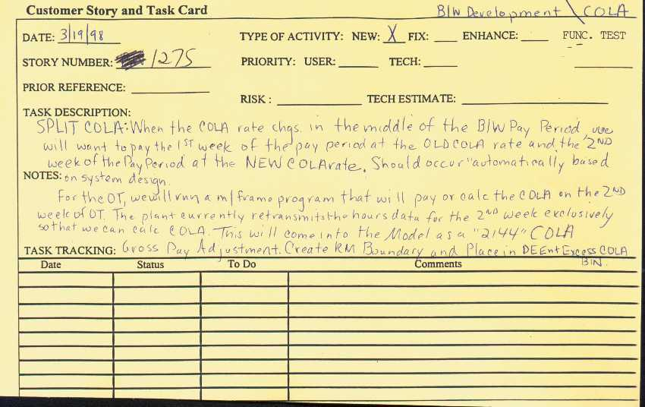
Story card
XP
Source: Jeffries
From the original C3 project:

Slide 4
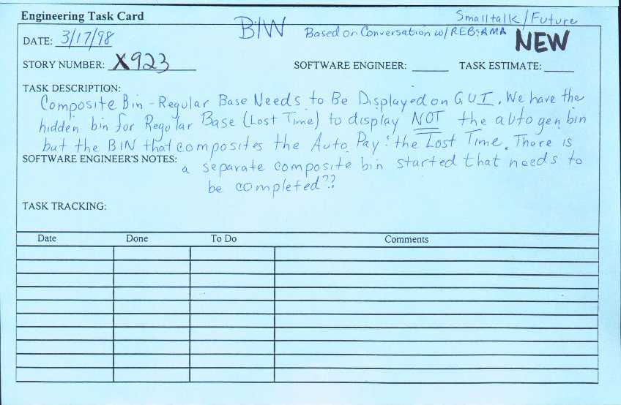
Task card
XP
Source: Jeffries
From the original C3 project:

Slide 5
Use case
Describes how to achieve single business goal or task through the interactions between external actors and system
One of the UML diagram types

Slide 6
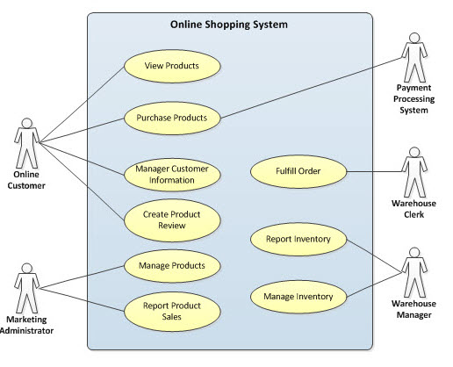
Use case example
Diagram source: T. Lockman (Wikimedia Commons)

Slide 7
Use cases vs user stories
After Cockburn
User story:
Very simple
Written by customer
Incomplete, possibly inaccurate
Does not handle exceptional cases
Starting point for additional discussions with customer
Use case:
More complex
Written by developer in cooperation with customer
Attempts to be complete, accurate
Should handle all possible cases
Intended to answer any developer questions about customer requirements without further interaction with customer
“Think of a user story as a use case at 2 bits of precision”

Slide 8
Product backlog
Scrum
Maintained throughout project
Property of product owner
Open and editable by anyone
Contains backlog items: broad descriptions of all potential features, prioritized by business value
Includes estimates of business value
Includes estimates of development effort, set by team
Visualized in “task board” (see next)

Slide 9
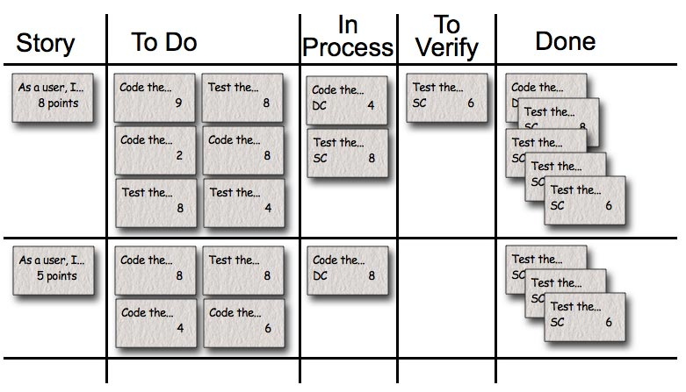
Task board, story board
Scrum
Source: Cohn, Anand
Used to see and change the state of the tasks of the current sprint: “to do”, “in progress”, “done”.
Benefits:
Transparency
Collaboration
Prioritization
Focus
Self-organization
Empiricism
“Humility”
Morale
Example source: Mountain Goat Software

Slide 10
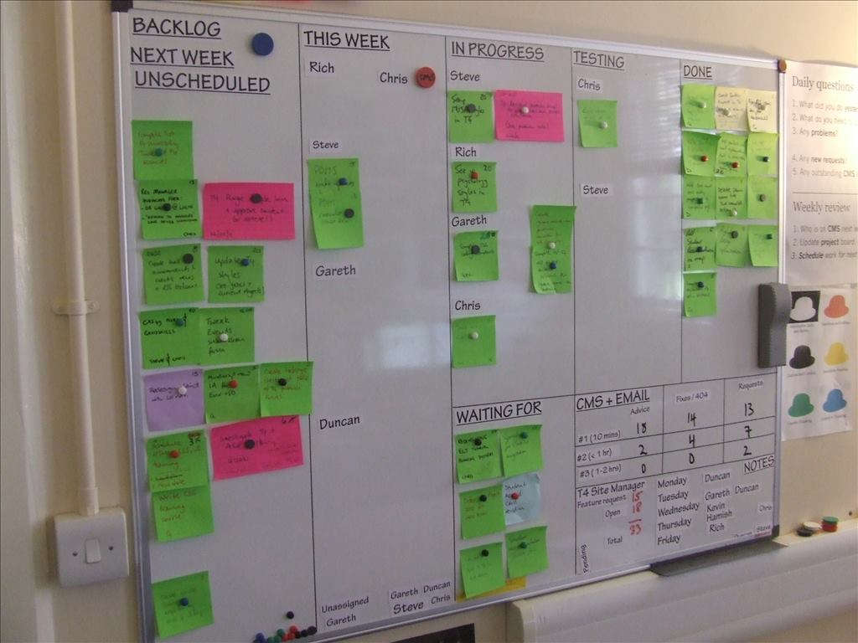
Story board
Source: Saunders
.

Slide 11
Velocity
Scrum
Measure of progress in a project:
Number of items delivered
Measured in tasks, user stories, backlog items…

Slide 12
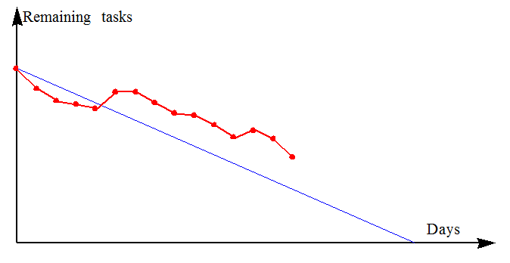
Burndown chart
Scrum
Publicly displayed chart, updated every day, showing, for the sprint backlog:
Remaining work
Progress
(Normally non-increasing)

Slide 13
Bullpen
XP
Single, open room
(See “ Informative workspace” principle)

Slide 14
Part E: Artifacts
What we have seen: Virtual and material tools that directly support agile concepts

